Slide 1
Brief history of AI and the rise of Generative AI
John R Ballesteros
Profesor Titular UN
jballes@unal.edu.co

Slide 2
Generative AI has evolved significantly, with key milestones shaping its development:
• Early 20th Century: Markov Chains– In 1906, Andrey Markov introduced Markov Chains, used to analyze text patterns and generate new sequences, laying a mathematical foundation for generative models.
• 2014: Deep Generative Models– Variational autoencoders (VAEs) and generative adversarial networks (GANs), introduced by Ian Goodfellow, enabled realistic image generation.
• 2017: Transformer Networks– Introduced by Vaswani et al., Transformers revolutionized natural language processing, outperforming LSTM models.

Slide 3
• 2018-2019: GPT-1 and GPT-2
• 2021: DALL-E– OpenAI’s DALL-E generated high-quality images from text prompts.
• 2022: Midjourney and Stable Diffusion– Democratized AI art creation, generating over 15 billion images by August 2023.

Slide 4
• Late 2022: ChatGPT– OpenAI’s ChatGPT revolutionized text-based tasks, gaining global at tention.
• 2023-2024: Multimodal Models– GPT4(2023), Meta’s ImageBind (2023), Google’s Gemini (2023), and Anthropic’s Claude 3.5 Sonnet (2024) advanced multimodal capabilities.
2025-Reasoning Models and Agents

Slide 5
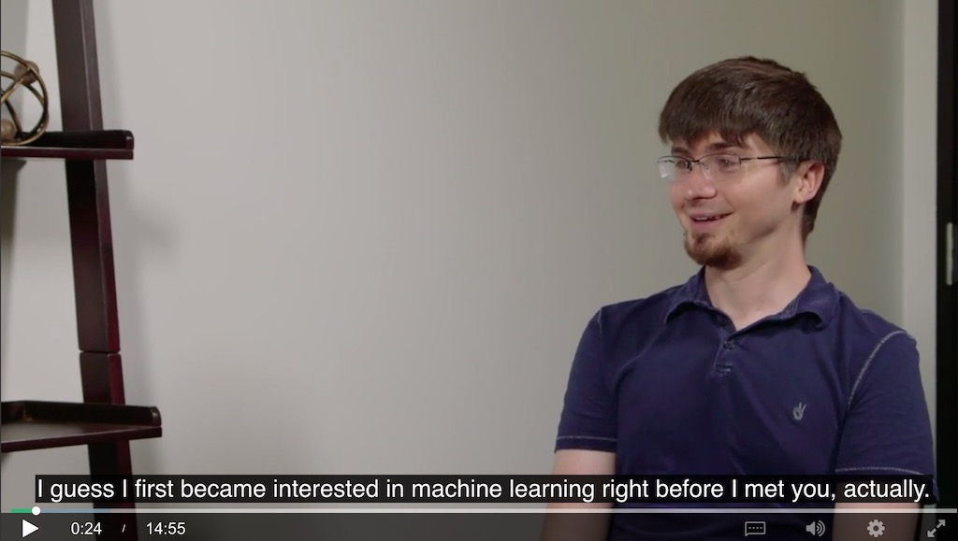

GANs
https://arxiv.org/abs/1406.2661
Attention is all you need
https://arxiv.org/abs/1706.03762
Esta foto de Autor desconocido está bajo licencia CC BY

Slide 6
Generative Ai vs non-generative AI, examples and use cases

Slide 7
Generative VS Discriminative Models
A Generative model (G) seeks to model a data distribution with the purpose of generate new samples (gi) of the same distribution P(X).
Training: Maximize likelihood max​logPθ​(X), (G) learns to generate new samples from P(x), Xnew​∼P(X).
Naive Bayes (supervised, there is Y, if not the model learns P(X))
Gaussian Mixture Models
VAEs
Diffusion models
Language models (GPT)
GANs

Slide 8
Discriminative models (D) focus on decision boundaries for Classification or Regression.
They learn the conditional probability P(Y∣X), where X is the input data and Y is the label or output. “Given this input, what is the correct output?”
Training: Maximize conditional likelihood max​logPθ​(Y∣X)
Logistic Regression
SVM
CNNs
YOLO (for detection)
Random Forest
U-Net (for segmentation)

Slide 9
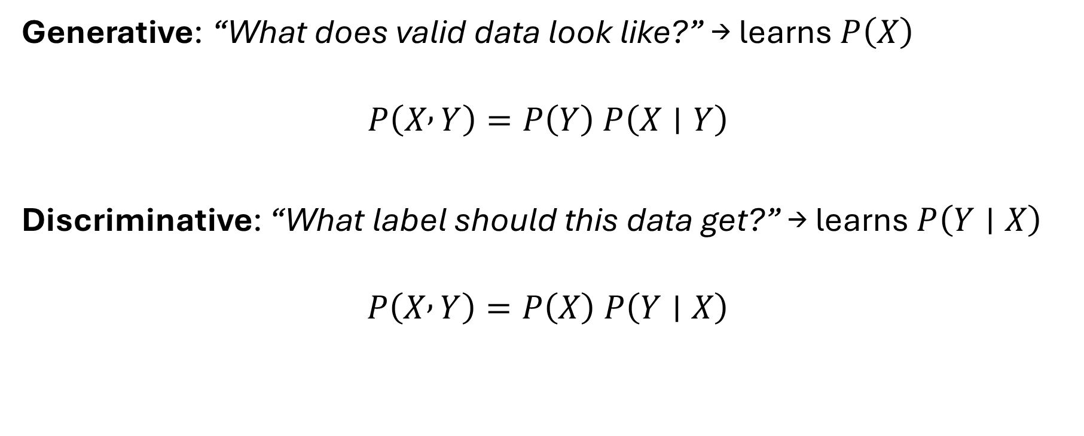
One-line intuition
Generative: “What does valid data look like?” → learns $P\left(X\right)$
$$P\left(X , Y\right)=P\left(Y\right) P\left(X∣Y\right)$$
Discriminative: “What label should this data get?” → learns $P\left(Y∣X\right)$
$$P\left(X , Y\right)=P\left(X\right) P\left(Y∣X\right)$$

Slide 10
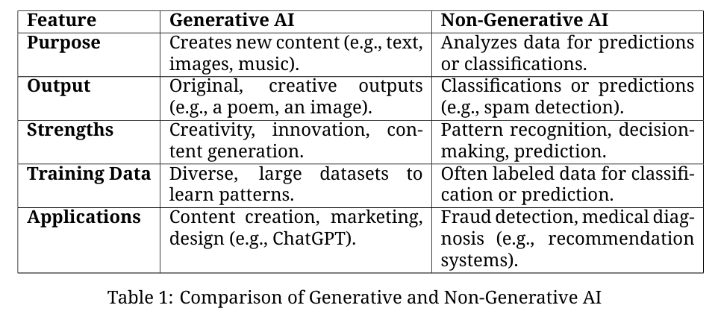
Generative and non-generative AI differ in purpose, output, and applications:

Slide 11
Exercise: Identifying Generative and Non-Generative AI Applications:
For each application, determine if it is generative or discriminative:
A chatbot generating human-like text responses. | genAi
Suggests movies based on viewing history. | Non GenAi
Translates text between languages. | genAi
Plays Go by analyzing board positions. | Discriminative Ai
Generates images from text descriptions. | GenAi
Classifies emails as spam or not. | Discriminative Ai
Makes driving decisions based on environment. | Discriminative Ai
Suggests text corrections. | GenAi
Identifies individuals from images. | Discriminative Ai
Generates music from text prompts. | GenAi

